Slide 1
pagination
Taught by Yossef Ayman Zedan

Slide 2
Overview
We use a large block of connected links for our pagination, making links hard to miss and easily scalable—all while providing large hit areas. Pagination is built with list HTML elements so screen readers can announce the number of available links. Use a wrapping <nav> element to identify it as a navigation section to screen readers and other assistive technologies.
<nav>
<ul class="pagination">
<li class="page-item"><a class="page-link" href="#">Previous</a></li>
<li class="page-item"><a class="page-link" href="#">1</a></li>
<li class="page-item"><a class="page-link" href="#">2</a></li>
<li class="page-item"><a class="page-link" href="#">3</a></li>
<li class="page-item"><a class="page-link" href="#">Next</a></li>
</ul>
</nav>

Slide 3
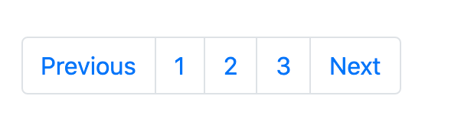
Overview

Slide 4
Working with icons
<nav>
<ul class="pagination">
<li class="page-item">
<a class="page-link" href="#">
<span >«</span>
</a>
</li>
<li class="page-item"><a class="page-link" href="#">1</a></li>

Slide 5
Working with icons
<li class="page-item"><a class="page-link" href="#">2</a></li>
<li class="page-item"><a class="page-link" href="#">3</a></li>
<li class="page-item">
<a class="page-link" href="#">
<span aria-hidden="true">»</span>
</a>
</li>
</ul>
</nav>

Slide 6
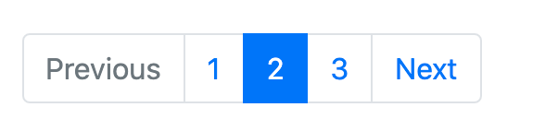
Disabled and active states
<li class="page-item disabled">
<a class="page-link" href="#">Previous</a>
</li>
<li class="page-item active">
<a class="page-link" href="#">2</a>
</li>

Slide 7
Disabled and active states
You can optionally swap out active or disabled anchors for <span>, or omit the anchor in the case of the prev/next arrows, to remove click functionality and prevent keyboard focus while retaining intended styles.
<li class="page-item active">
<span class="page-link">2</span>
</li>
<li class="page-item disabled">
<span class="page-link">Previous</span>
</li>

Slide 8
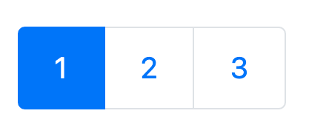
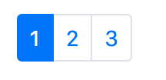
Sizing
Fancy larger or smaller pagination? Add .pagination-lg or .pagination-sm for additional sizes.
<ul class="pagination pagination-lg"> </ul>
<ul class="pagination pagination-sm"> </ul>

Slide 9
Alignment
Change the alignment of pagination components with flexbox utilities
<nav>
<ul class="pagination justify-content-center">
<li class="page-item disabled">
<a class="page-link" href="#">Previous</a>
</li>
<li class="page-item"><a class="page-link" href="#">1</a></li>
<li class="page-item"><a class="page-link" href="#">2</a></li>
<li class="page-item"><a class="page-link" href="#">3</a></li>
<li class="page-item">
<a class="page-link" href="#">Next</a>
</li>
</ul>
</nav>

Slide 10

Alignment

Slide 11

Alignment
<ul class="pagination justify-content-end"> </ul>

